Slide 1
Automated design of DNA nanostructures through cycle construction
A.J. Vetturini avetturi@andrew.cmu.edu
Professor Rebecca E. Taylor bex@andrew.cmu.edu
Professor Jonathan Cagan cagan@cmu.edu
Notes:
Say what does DNA does at the start
“How we build nanoscale to microscale structures using DNA as a construction material rather than a biological material”

Slide 2
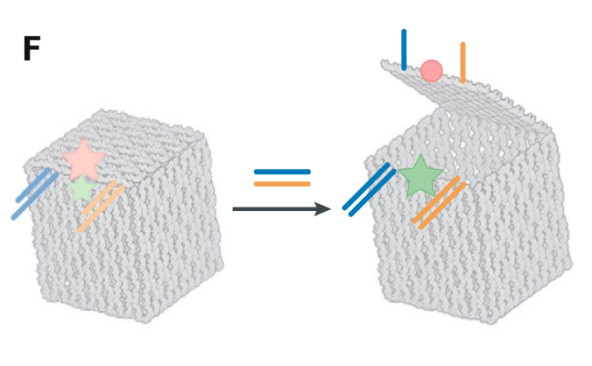
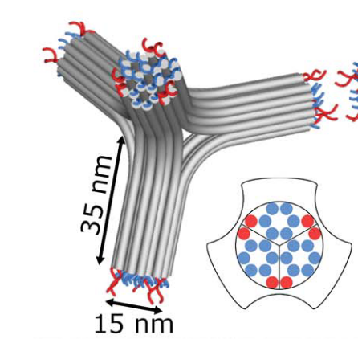

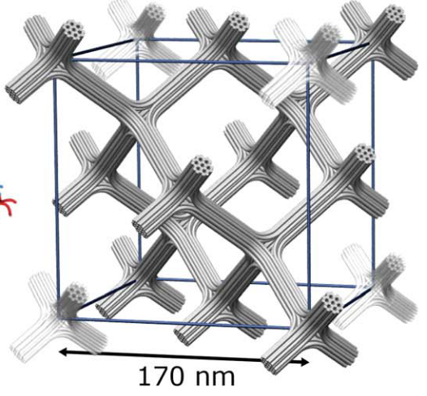
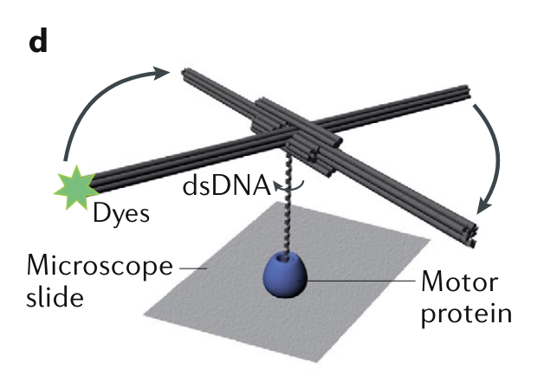
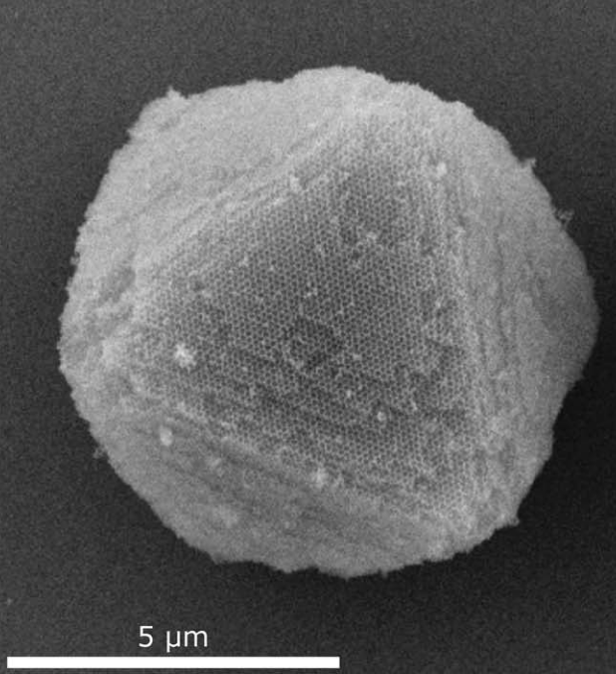
DNA origami nanostructures are on the scale of ~20-100 nanometers and have been used in a variety of applications
Introduction
Methodology
Results
Conclusions
Q&A
Biological Applications
Inorganic Applications
A
T
DNA origami building block
G
C
C
G
Drug delivery vehicles^{2,3}
Unit cell of many blocks
https://www.britannica.com/science/DNA
DNA origami¹ consists of:
Scaffold (~7k nucleotides (nts))
Many short, synthetic staples (20-60 nts)
And a thermal annealing process enables self-assembly!
Colloidal crystals and metamaterials^{5,6}
Dynamic structures⁴
1. Rothemund, P. W. K. Nature 440, no. 7082 (2006): 297–302.
2. Andersen, E. et al. Nature 459, 73–76 (2009).
3. Douglas, S. M., Bachelet, I. and Church, G. M. Science 335, no. 6070 (2012): 831–34.
4. Kosuri, P. et al. Nature 572, no. 7767 (2019): 136–40.
5. Liu, H. et al. Science 384, no. 6697 (2024): 776–81.
6. Posnjak, G. et al. Science 384, no. 6697 (2024): 781–85.
Notes:
DNA Rotation: Despite the potential of rotation measurements to transform our understanding of genome-processing reactions, measuring DNA rotation remains a difficult task.
Stober reaction = tetra-ethyl-orthosilicate (ETOS) + Trimethocysyl propyl Trimethyl ammonium

Slide 3
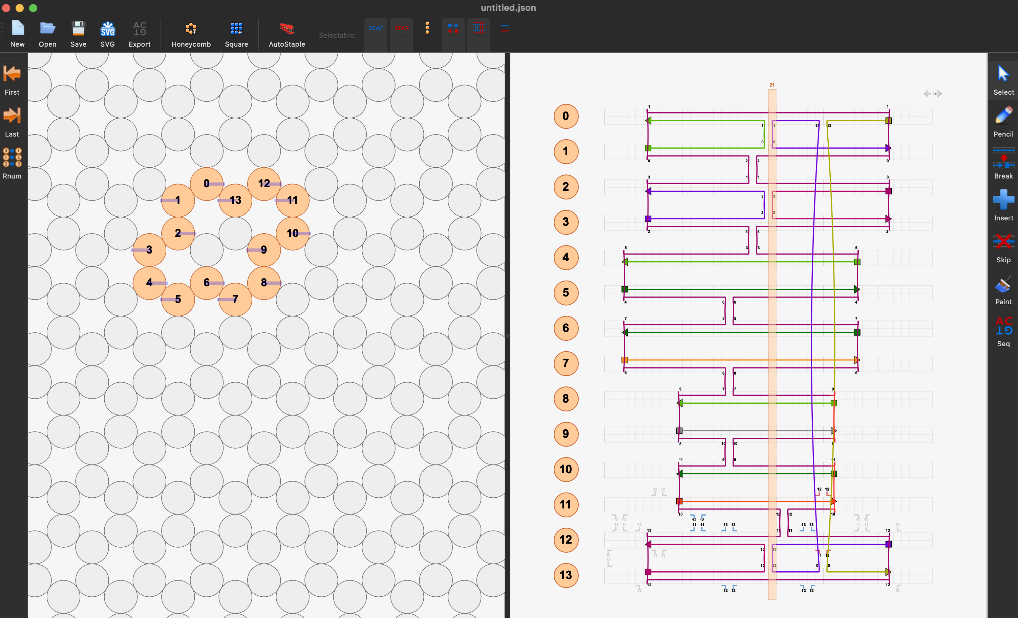
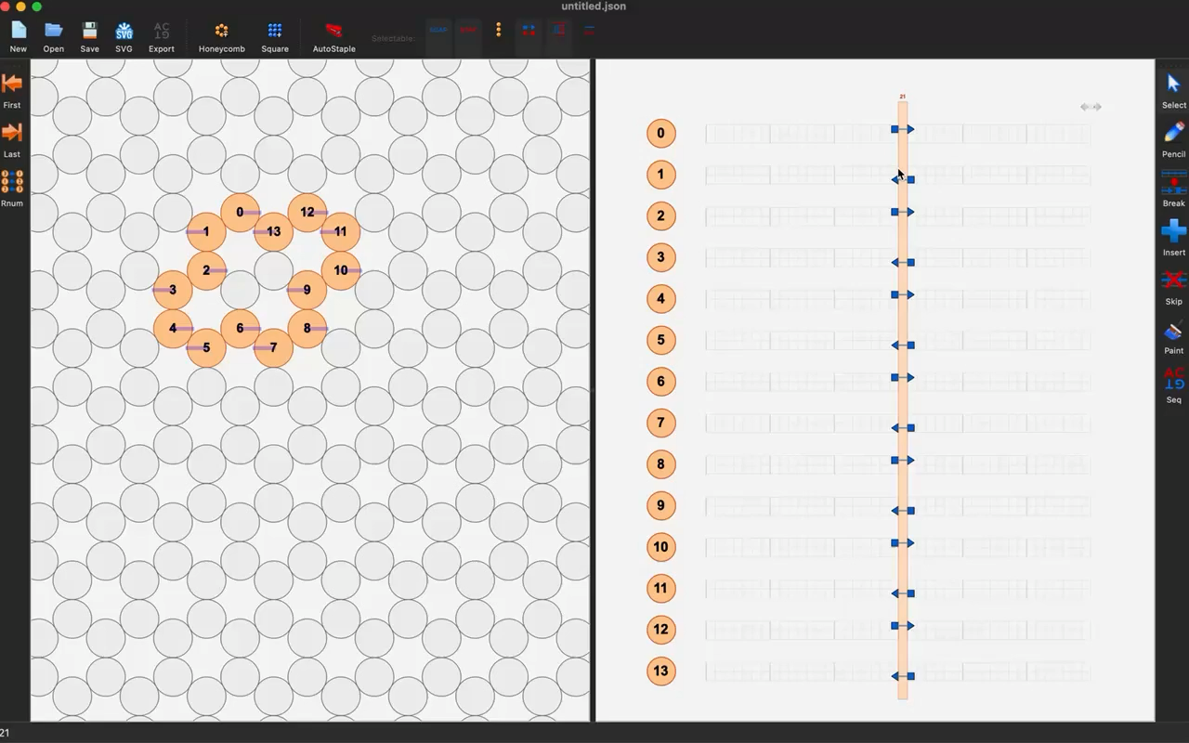
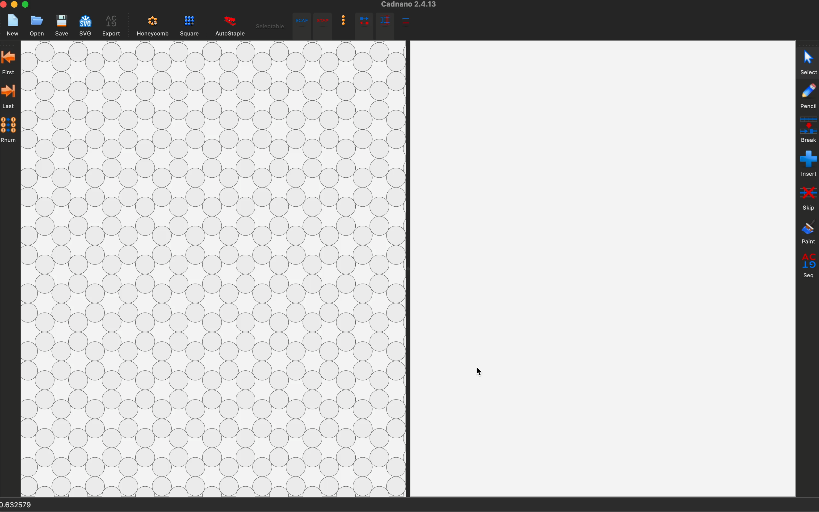
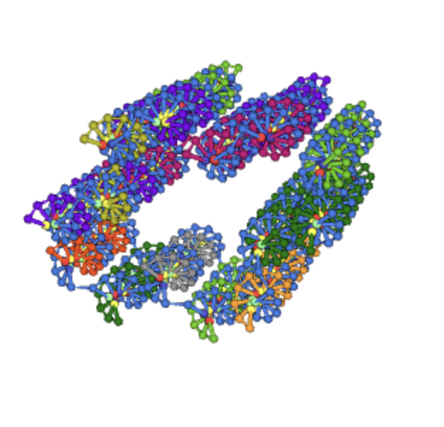
However, the design of DNA origami nanostructures is a time consuming and complex problem
Introduction
Methodology
Results
Conclusions
Q&A
3D Extrusion-like structures are difficult, but feasible
3 step design
process
Cross section
→ Controls mechanical properties
Scaffold routing
→ Requirement of DNA origami
Staple design
→ Glue of design
Video of caDNAno: Douglas, S. et al. Nucleic Acids Research 37, no. 15 (2009): 5001–6.
Notes:
EXPLAIN
Mention this is called caDNAno

Slide 4
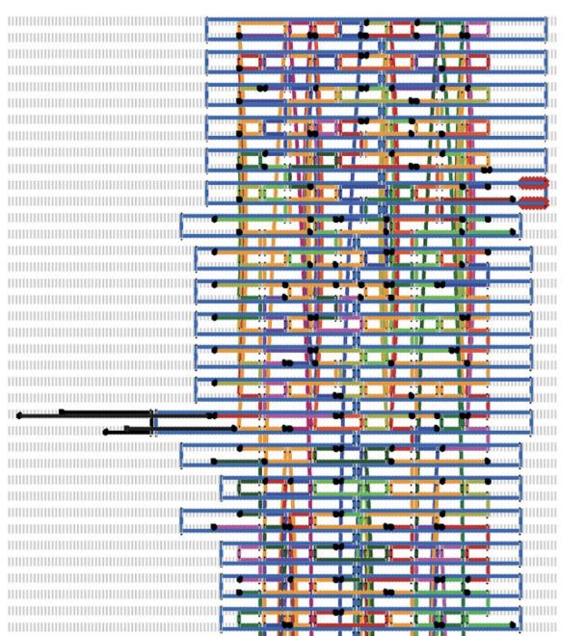
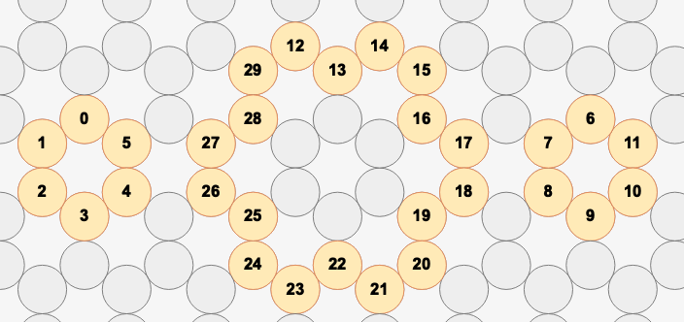
Complex 3D DNA origami become even more difficult to manually design
Introduction
Methodology
Results
Conclusions
Q&A
Challenge | Why?
Circular | Scaffold ssDNAs are naturally circular
Length | Need to use at least ~85% of a scaffold for folding to occur
Directionality | DNA origami typically uses Holliday junctions fot stability and to “turn around”
Cross section
Scaffold
Staples
3 step design
process
Cross section
→ Controls mechanical properties
Scaffold routing
→ Requirement of DNA origami
Staple design
→ Glue of design
1. Kosuri, P. et al. Nature 572, no. 7767 (2019): 136–40.
2. Douglas, S. et al. Nucleic Acids Research 37, no. 15 (2009): 5001–6.
Images from Kosuri et al.¹
Notes:
EXPLAIN

Slide 5
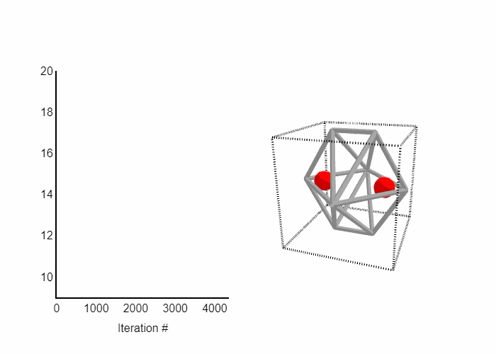
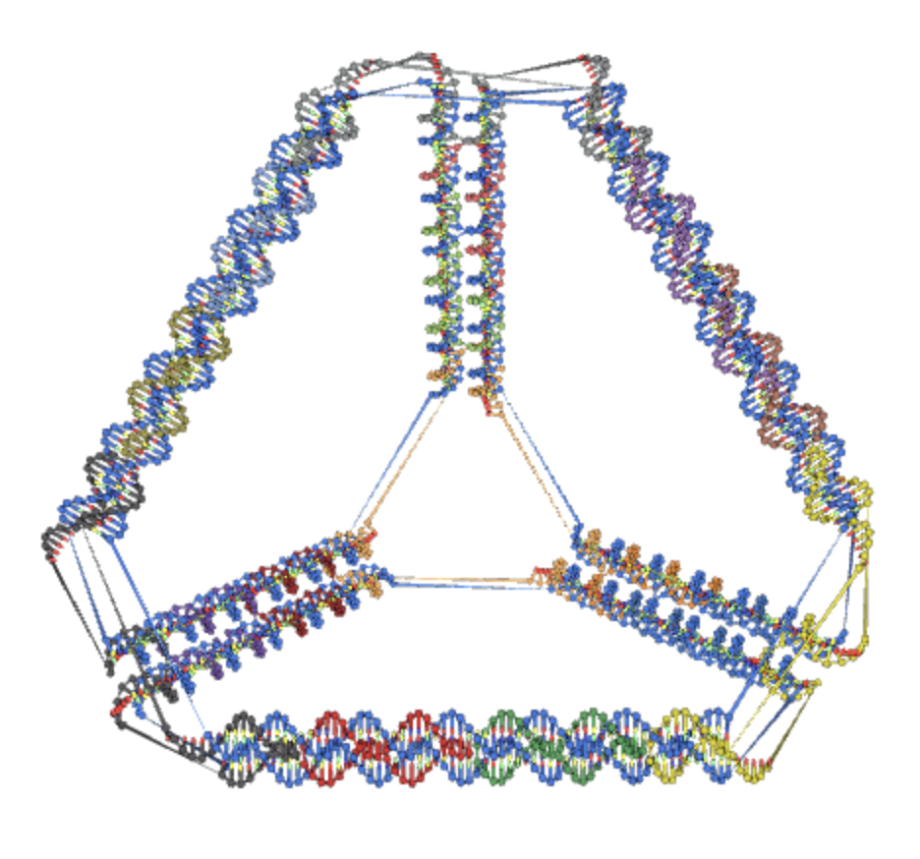
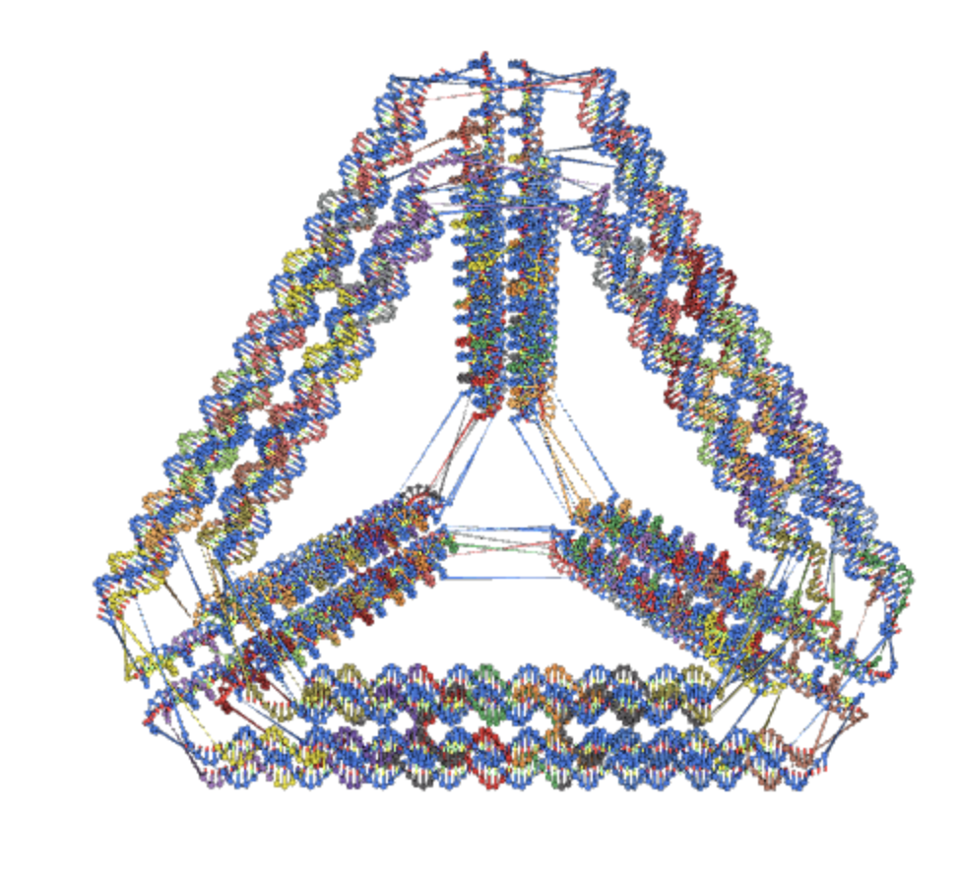
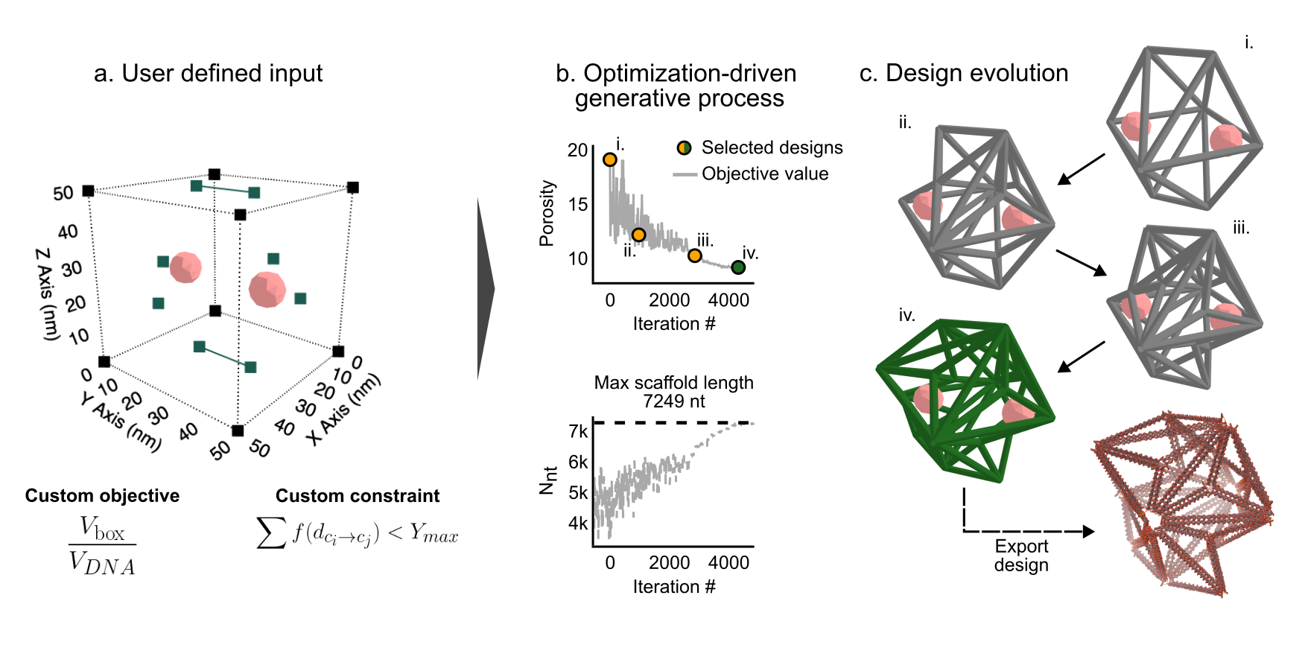
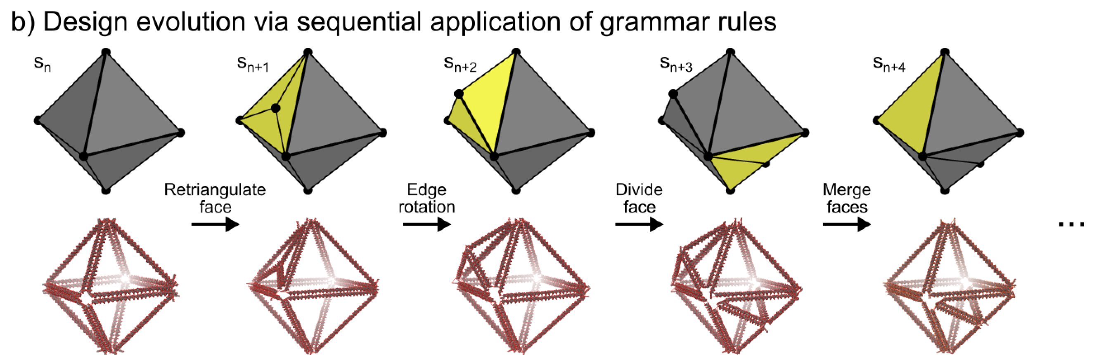
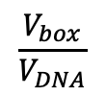
Design automation solutions exist but only for specific classes of inputs
Introduction
Methodology
Results
Conclusions
Q&A
Manual conception
Automated nucleotide-level design^{1,2}
Automated conception
Automated nucleotide-level design³
Designer imposes constraints
Shape annealing⁴ generates design
Designer creates mesh
$$\frac{V_{box}}{V_{DNA}}$$
Designer selects either soft or stiff automation tool
Iteration #
Rule 1
Rule 2
1. Jun, H. et al. Nucleic Acids Research 49, no. 18 (2021): 10265–74.
2. Benson, E. et al. Nature 523, no. 7561 (2015): 441–44.
3. Vetturini, A. J., Cagan, J., and Taylor, R. E., Nucleic Acids Research 53, no. 2 (2025): gkae1268.
4. Cagan, J., and Mitchell, W. J. Environment and Planning B: Planning and Design 20, no. 1 (1993): 5–12.
Notes:
We can only define spaces that can be captured through wireframe automation which is limiting, and to be able to more broadly apply the shape annealing approach we need new automation tools
Show the grammar

Slide 6
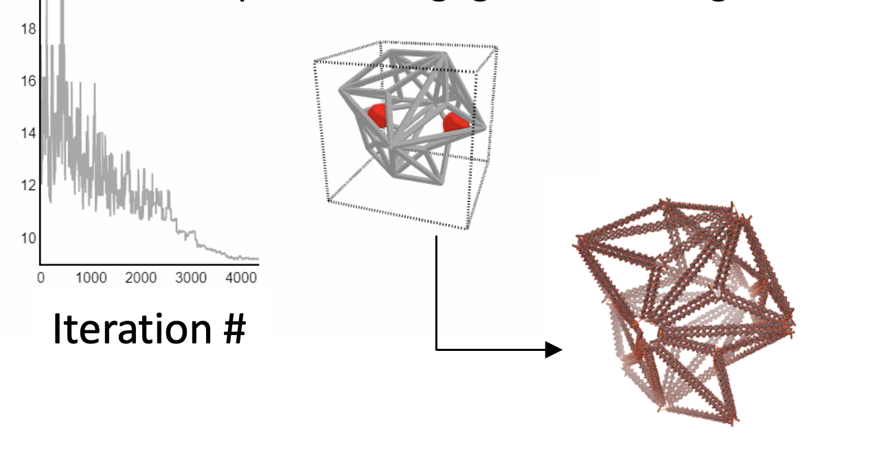
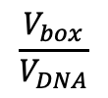
However, the grammar is limited by the types of nucleotide-level automation tools avilable
Introduction
Methodology
Results
Conclusions
Q&A
Automated conception
Automated nucleotide-level design¹
A grammar for designer metamaterials will require automation of strut-based DNA origami
Designer imposes constraints
Shape annealing² generates design
Scaffold start / stop at same place
$$\frac{V_{box}}{V_{DNA}}$$
Images from 3
Strut-based nanostructure automation will require:
Designing the cross section for efficient scaffold usage
Novel scaffold routing algorithm
Grammar:
Rule 1
Rule 2
1. Vetturini, A. J., Cagan, J., and Taylor, R. E., Nucleic Acids Research 53, no. 2 (2025): gkae1268.
2. Cagan, J., and Mitchell, W. J. Environment and Planning B: Planning and Design 20, no. 1 (1993): 5–12.
3. Posnjak, G. et al. Science 384, no. 6697 (2024): 781–85.
Notes:
We can only define spaces that can be captured through wireframe automation which is limiting, and to be able to more broadly apply the shape annealing approach we need new automation tools

Slide 7
The input to this algorithm consists of a wireframe model-based input and a desired N number of helices-per-edge
Introduction
Methodology
Results
Conclusions
Q&A
Input 1) mesh and 2) N-per-edge
Algorithm Constraints
Input mesh must contain at least 2 edges
Single connected model
Edge lengths must be at least 14 nm
Constant & even N DNA helices-per-edge
35 nm
24 DNA Helices
Specify N=24
Disconnected model
Non-constant N-per-edge
N=6
35 nm
N=14
Notes:
Emphasize / calrify scaffold routing (and not be knotted)

Slide 8
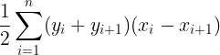
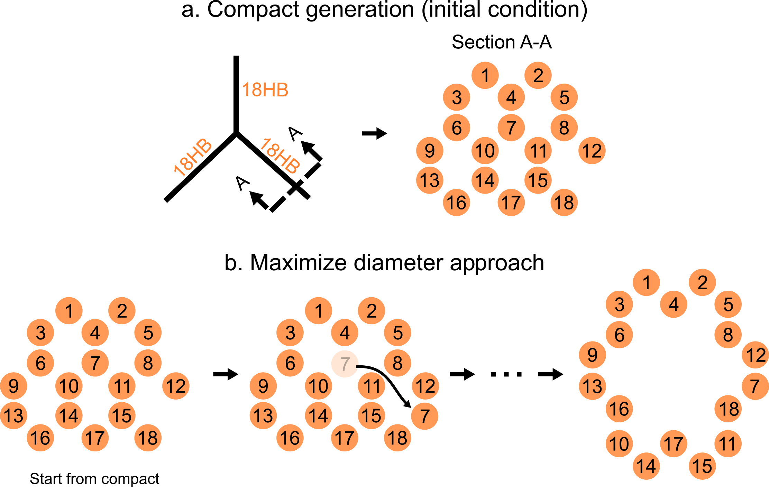
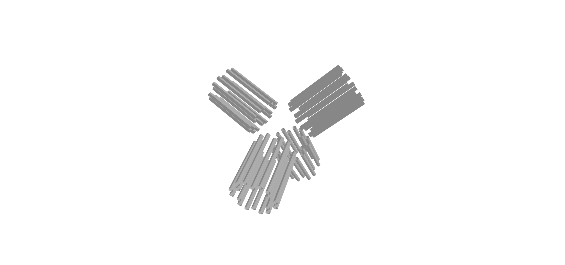
First a cross section is designed to enable efficient usage of the scaffold
Introduction
Methodology
Results
Conclusions
Q&A
Designer input
max
s.t.
# neighbors > 1
N_{h,ring} = N_{max}
35 nm
Helices are populated into discrete positions
Cross section applied to each edge of input
Specify N=18
3 step design
process
Cross section
→ Controls mechanical properties
Scaffold routing
→ Requirement of DNA origami
Staple design
→ Glue of design
Notes:
Clarify shoelace formula is CROSS-SECTIONAL AREA (method for calculating the area of a polygon given the coordinates of its vertices)

Slide 9
The model is then converted into a graph that allows for a cycle to be used for the scaffold routing
Introduction
Methodology
Results
Conclusions
Q&A
Input
Convert to graph
Strut-based
35 nm
Add backtracking nodes & edges
Find cycle
Edge weight is edge length
Vertices contain 3D (X, Y, Z)
30 nm
30 nm
Mesh-based
Find cycle
25 nm
25 nm
Notes:
For each vertex v connected to a pendant vertex u, we introduce a new vertex v'. We then add an edge between v and v', and we replace the edge (v, u) with (v', u). Furthermore, we add edges from v' to all neighbors of v (excluding u).
Mention backtracking or a Local Greedy TSP that scales in polynomial time (as we do not need the Hamiltonian / true minimal cycle, just a good enough approximation that ideally traverses the edges of the input mesh)

Slide 10
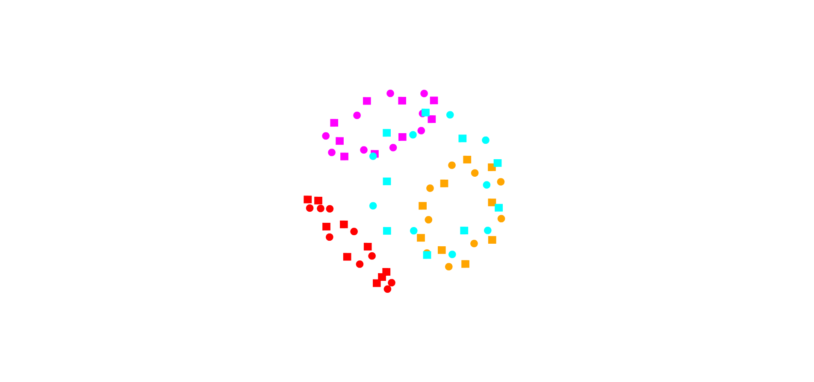
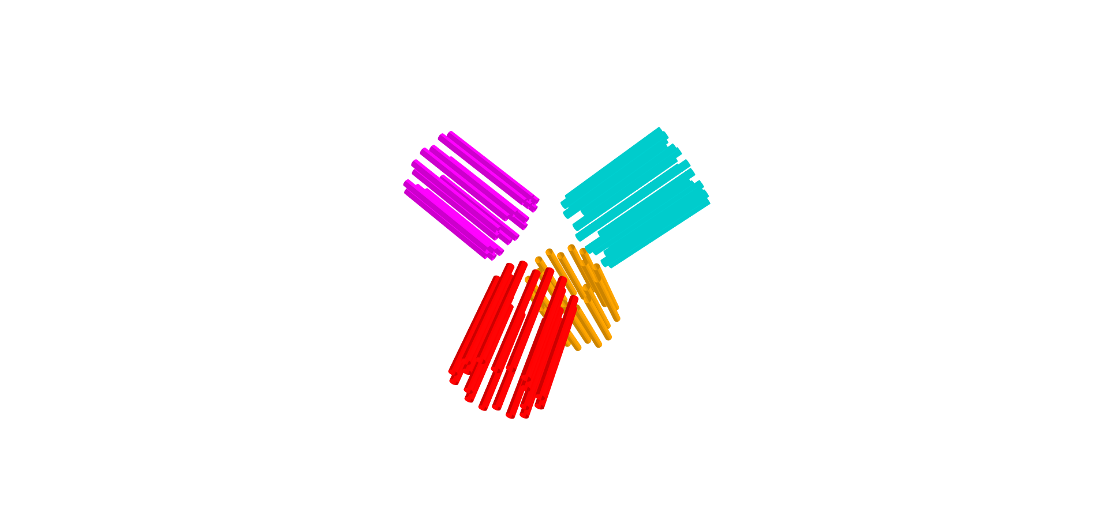
Next, bundles are rotated in-plane to find an optimal configuration that minimizes total distance
Introduction
Methodology
Results
Conclusions
Q&A
At this point we have a
Cycle: Accounts for circular scaffold
Cross-section: Accounts for mechanical properties
But these then need to be combined for a scaffold routing that is not knotted
Input
Automation Algorithm
1
2
…
1
…
1
…
1
∞
∞
…
d
d
…
1
Goal
Find a configuration that minimizes total distance
1
1
+
∞
∞
…
d
d
1
2
2
…
…
1
2
35 nm
1
1
d
d
…
∞
d
…
…
1
1
1
2
1
d
d
…
d
∞
…
…
1
1
1
Specify N=18
Cycle
Cross section
2
2
1
Each vertex form a linear assignment problem leveraging the directionality of DNA

Slide 11
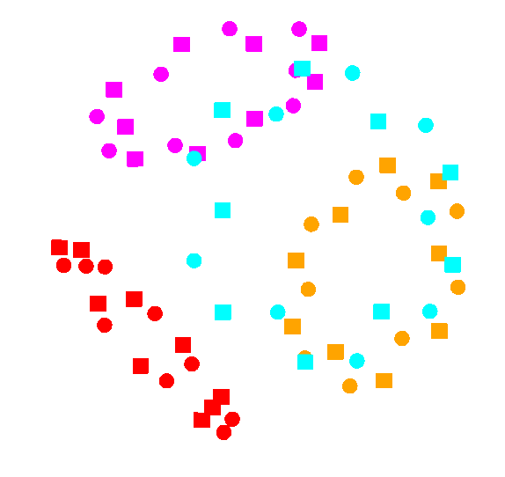
Next, bundles are rotated in-plane to find an optimal configuration that minimizes total distance
Introduction
Methodology
Results
Conclusions
Q&A
At this point we have a
Cycle: Accounts for circular scaffold
Cross-section: Accounts for mechanical properties
But these then need to be combined for a scaffold routing that is not knotted
Input
Automation Algorithm
1
2
…
1
…
1
…
1
∞
∞
…
d
d
…
1
Goal
Find a configuration that minimizes total distance
1
1
+
∞
∞
…
d
d
1
2
2
…
…
1
2
35 nm
1
1
d
d
…
∞
d
…
…
1
1
1
2
1
d
d
…
d
∞
…
…
1
1
1
Specify N=18
Cycle
Cross section
2
2
1
Each vertex form a linear assignment problem leveraging the directionality of DNA
Notes:
We use Hungarian because 1) both aspects of bipartite graph MUST have same number of vertices AND Hungarian is a global algorithm

Slide 12
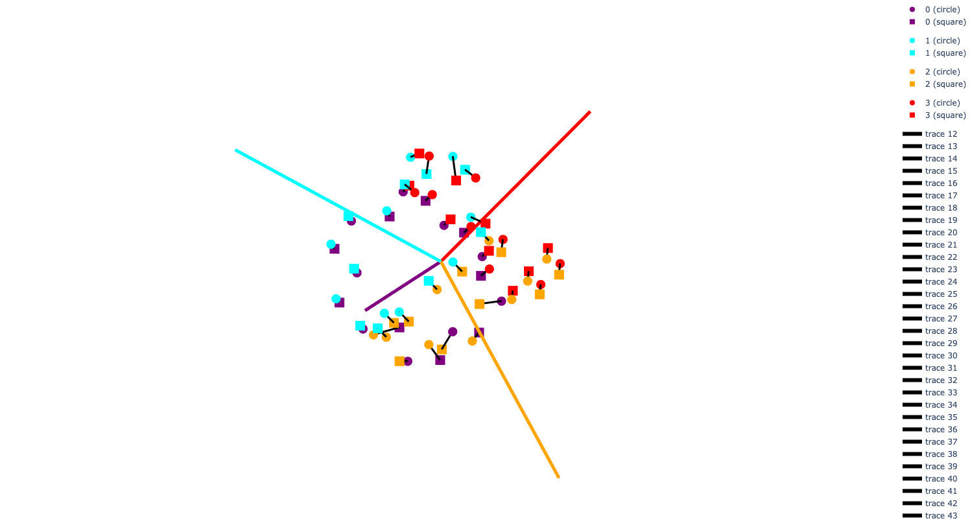
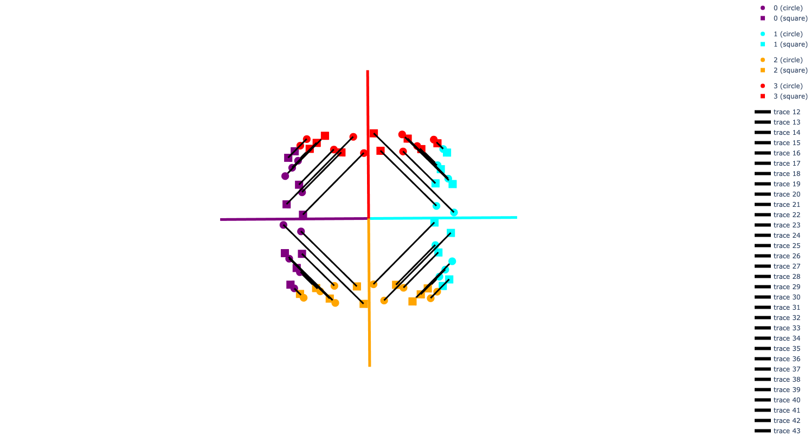
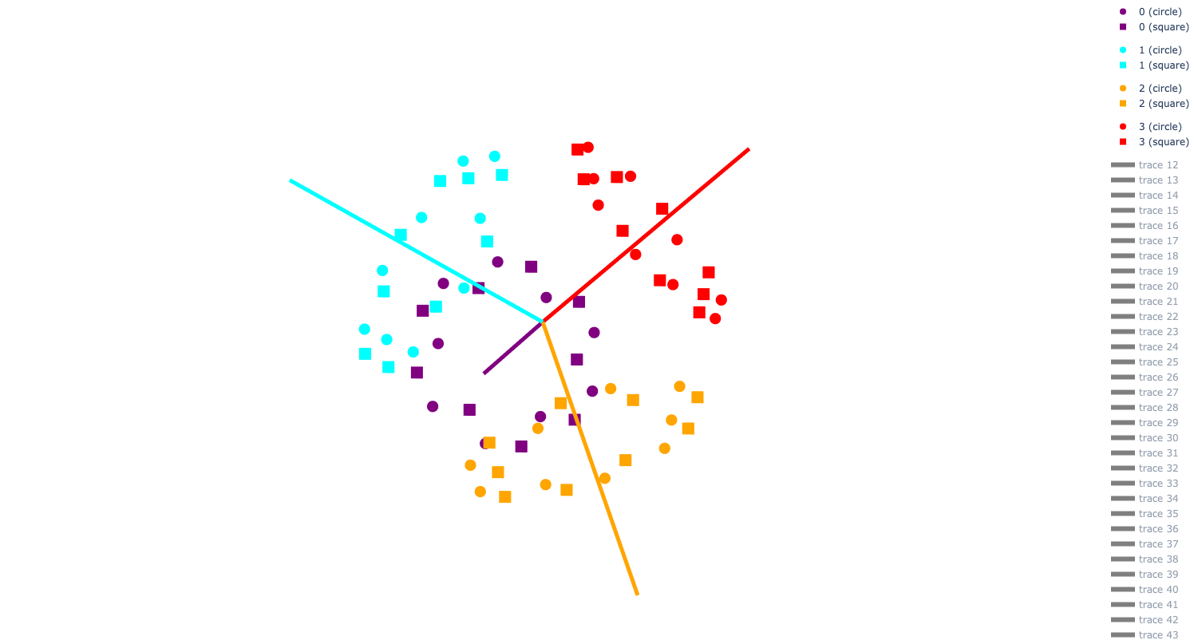
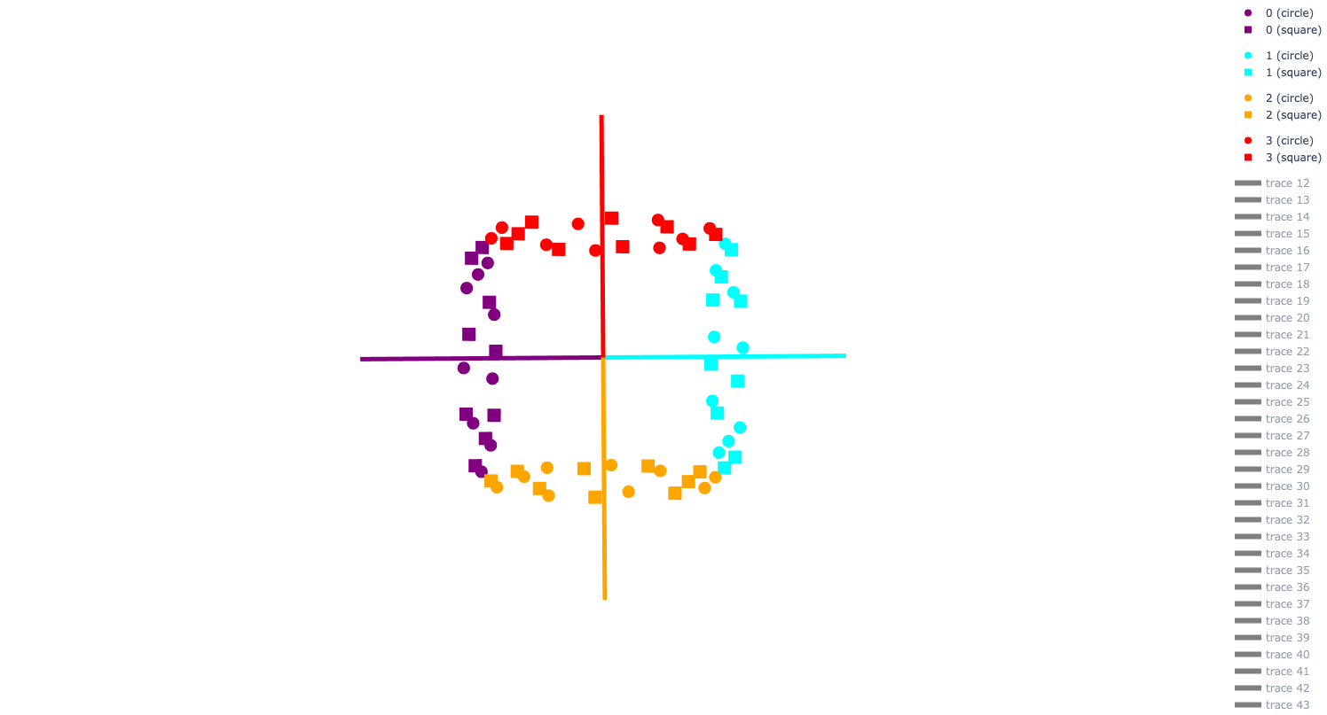
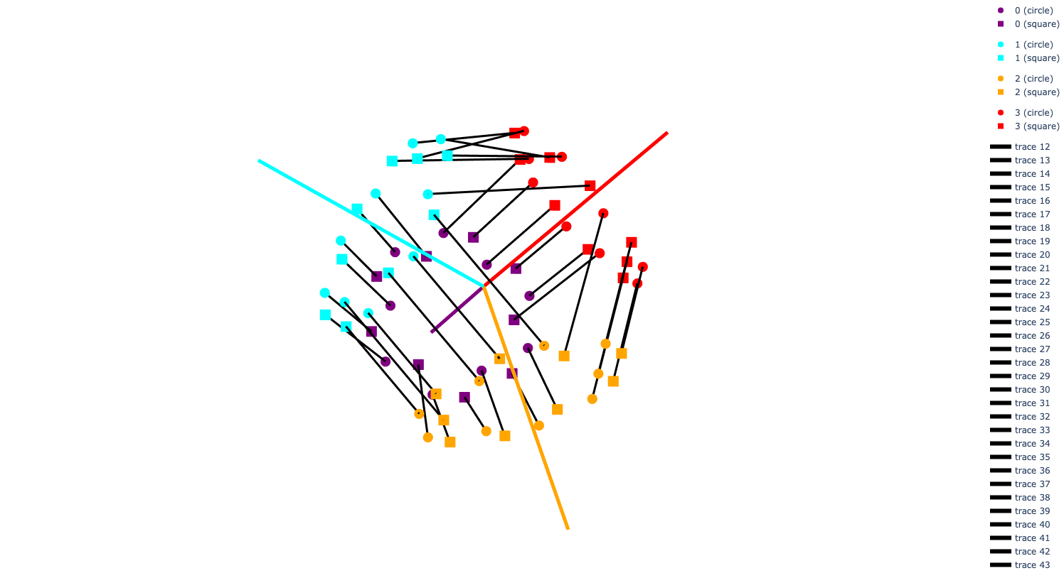
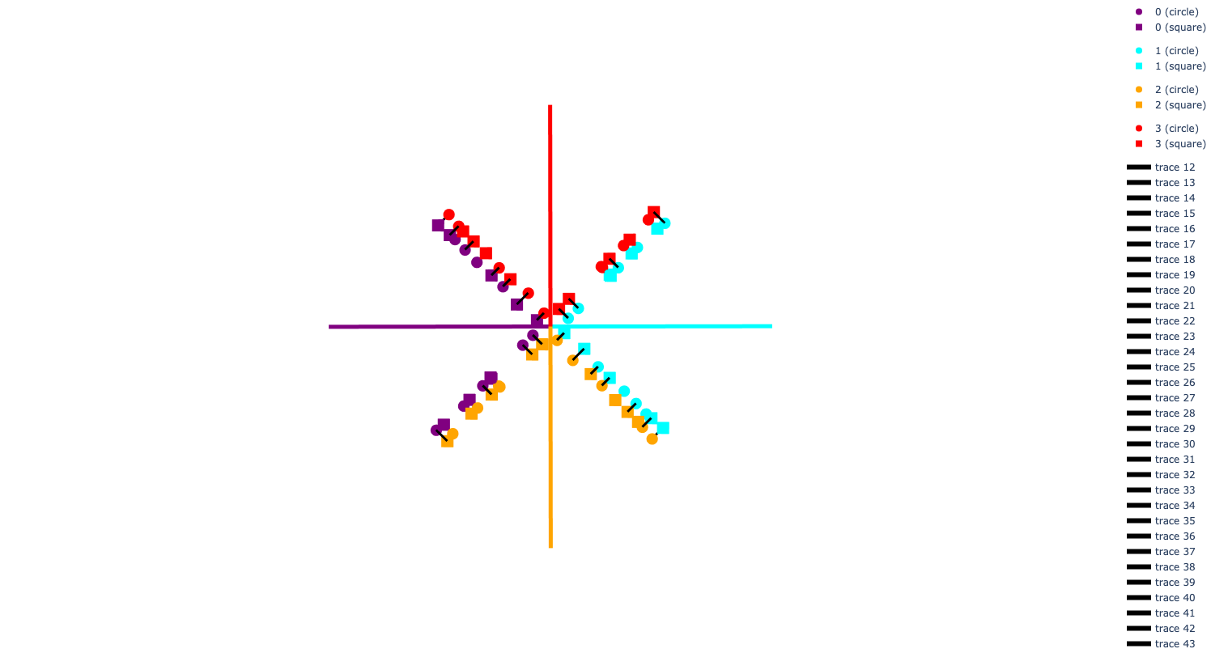
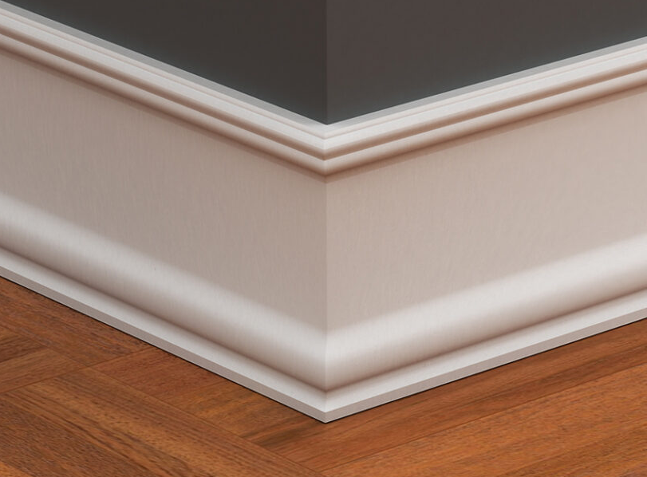
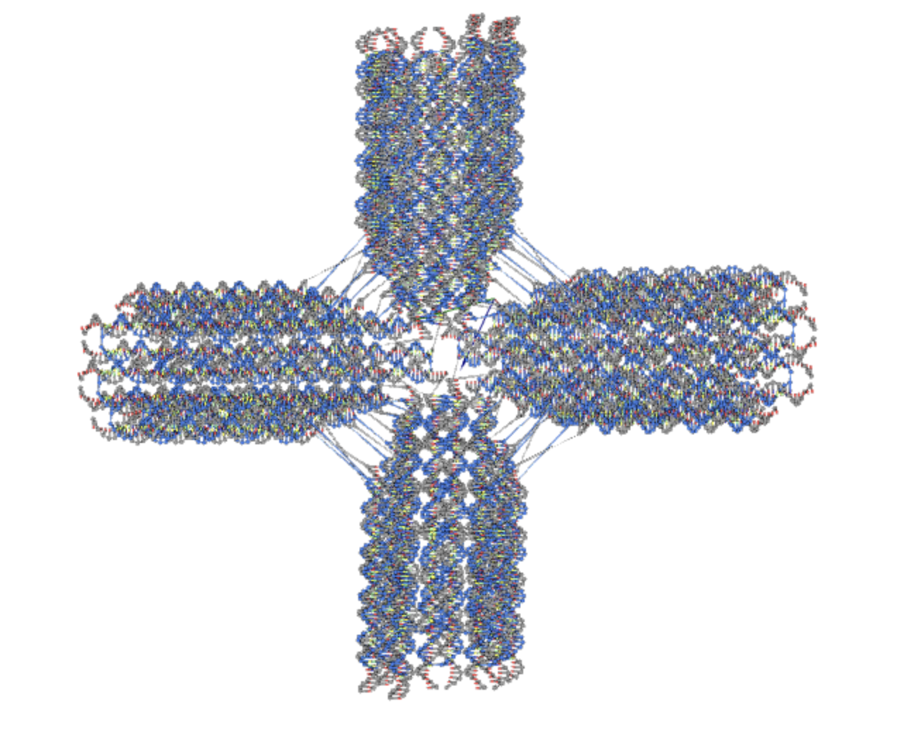
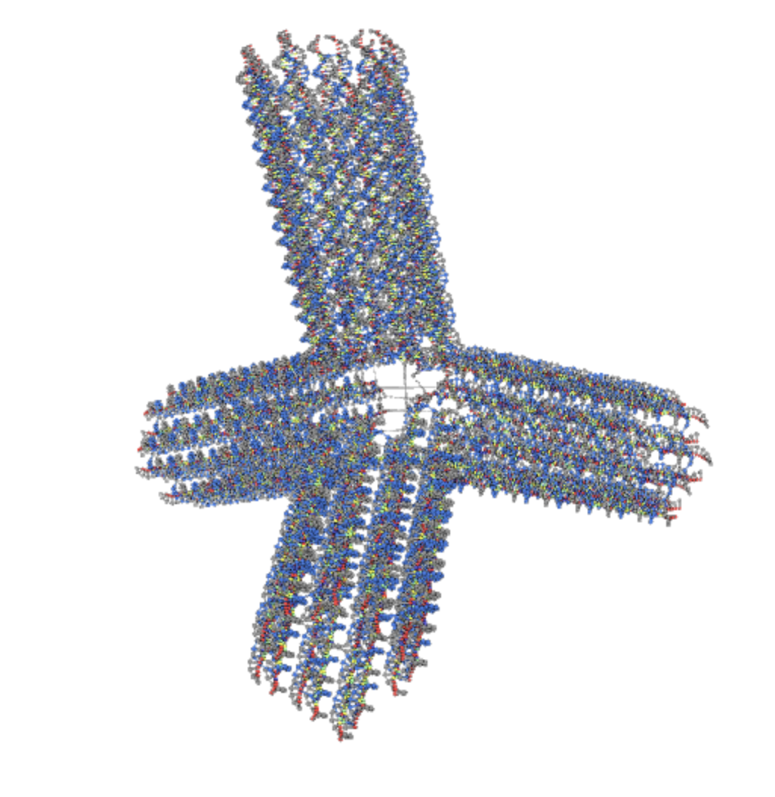
Finally, a mitering procedure leveraging the geometry of DNA can be employed to complete the design automation
Introduction
Methodology
Results
Conclusions
Q&A
AA
AA
Top View
1
2
1
2
Image from https://www.nationalassemblers.com/post/floor-trim-selection
Miter corners for flush fit
For each connection, move towards shared vertex by 0.34 nm until thresold met
35 nm
Without mitering, these designs would have similar outputs
35 nm
Specify N=18
Specify N=18

Slide 13
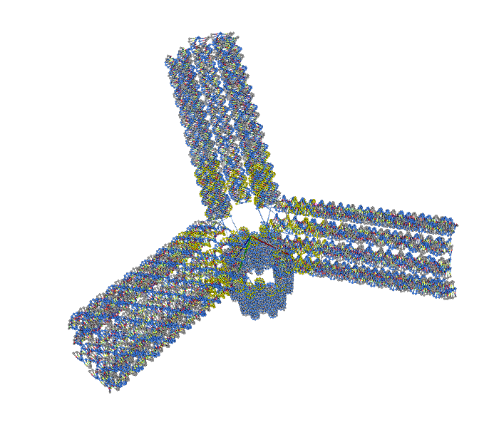
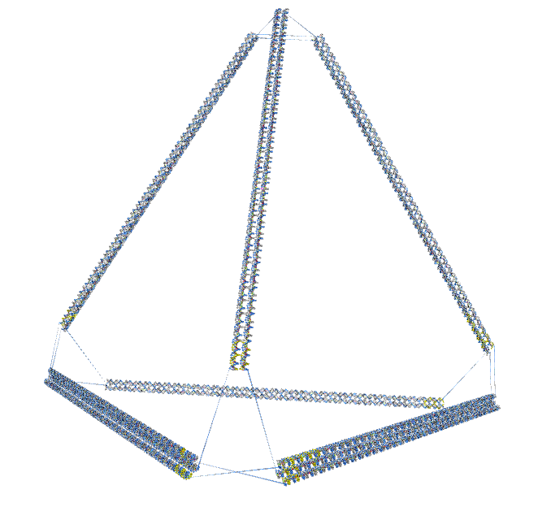
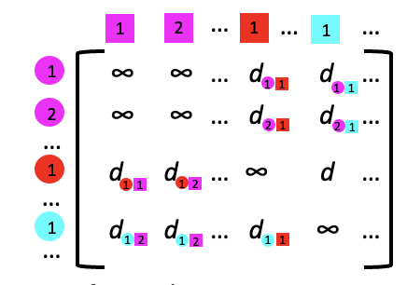
The full design automation pipeline
Introduction
Methodology
Results
Conclusions
Q&A
Input
1. Generate cross-section
2. Convert to graph & find cycle
30 nm
35 nm
25 nm
N=18
N=2
N=18
max
5. Staple¹ & export
4. Miter bundles
3. Perform scaffold routing
1. Aksel, T., Navarro, E. J., Fong, N. and Douglas, S. M., Proceedings of the National Academy of Sciences 121, no. 48 (2024): e2406769121.

Slide 14
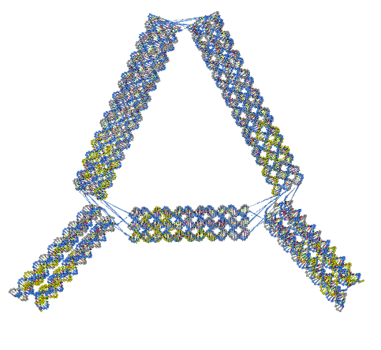
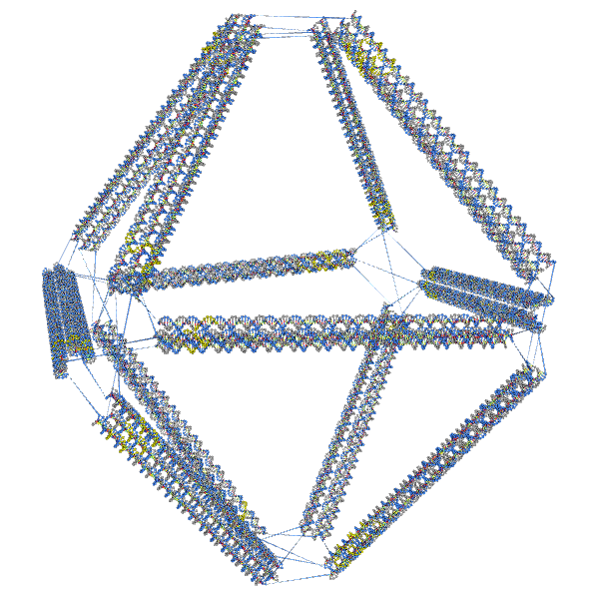
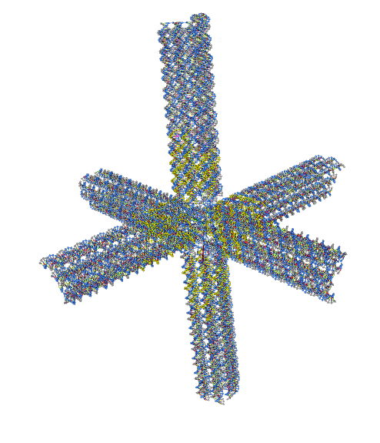
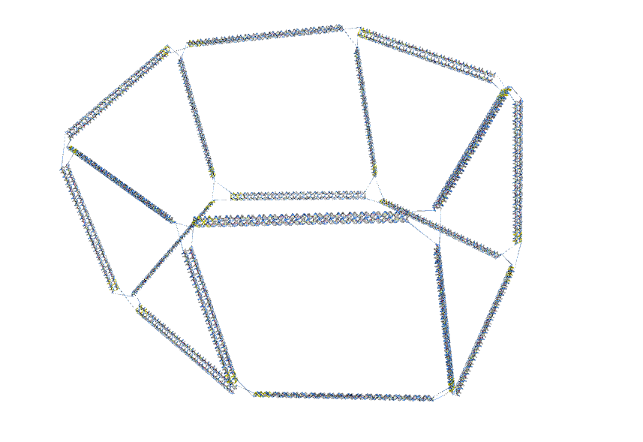
The design automation algorithm presented spans both wireframe and strut-based structures
Introduction
Methodology
Results
Conclusions
Q&A
Strut-based
Wireframe
N=2
N=6
N=18
N=4
N=10
N=2
Visualization from oxView: Poppleton, E. et al. Nucleic Acids Research 48, no. 12 (2020): e72.

Slide 15
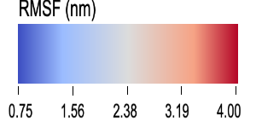
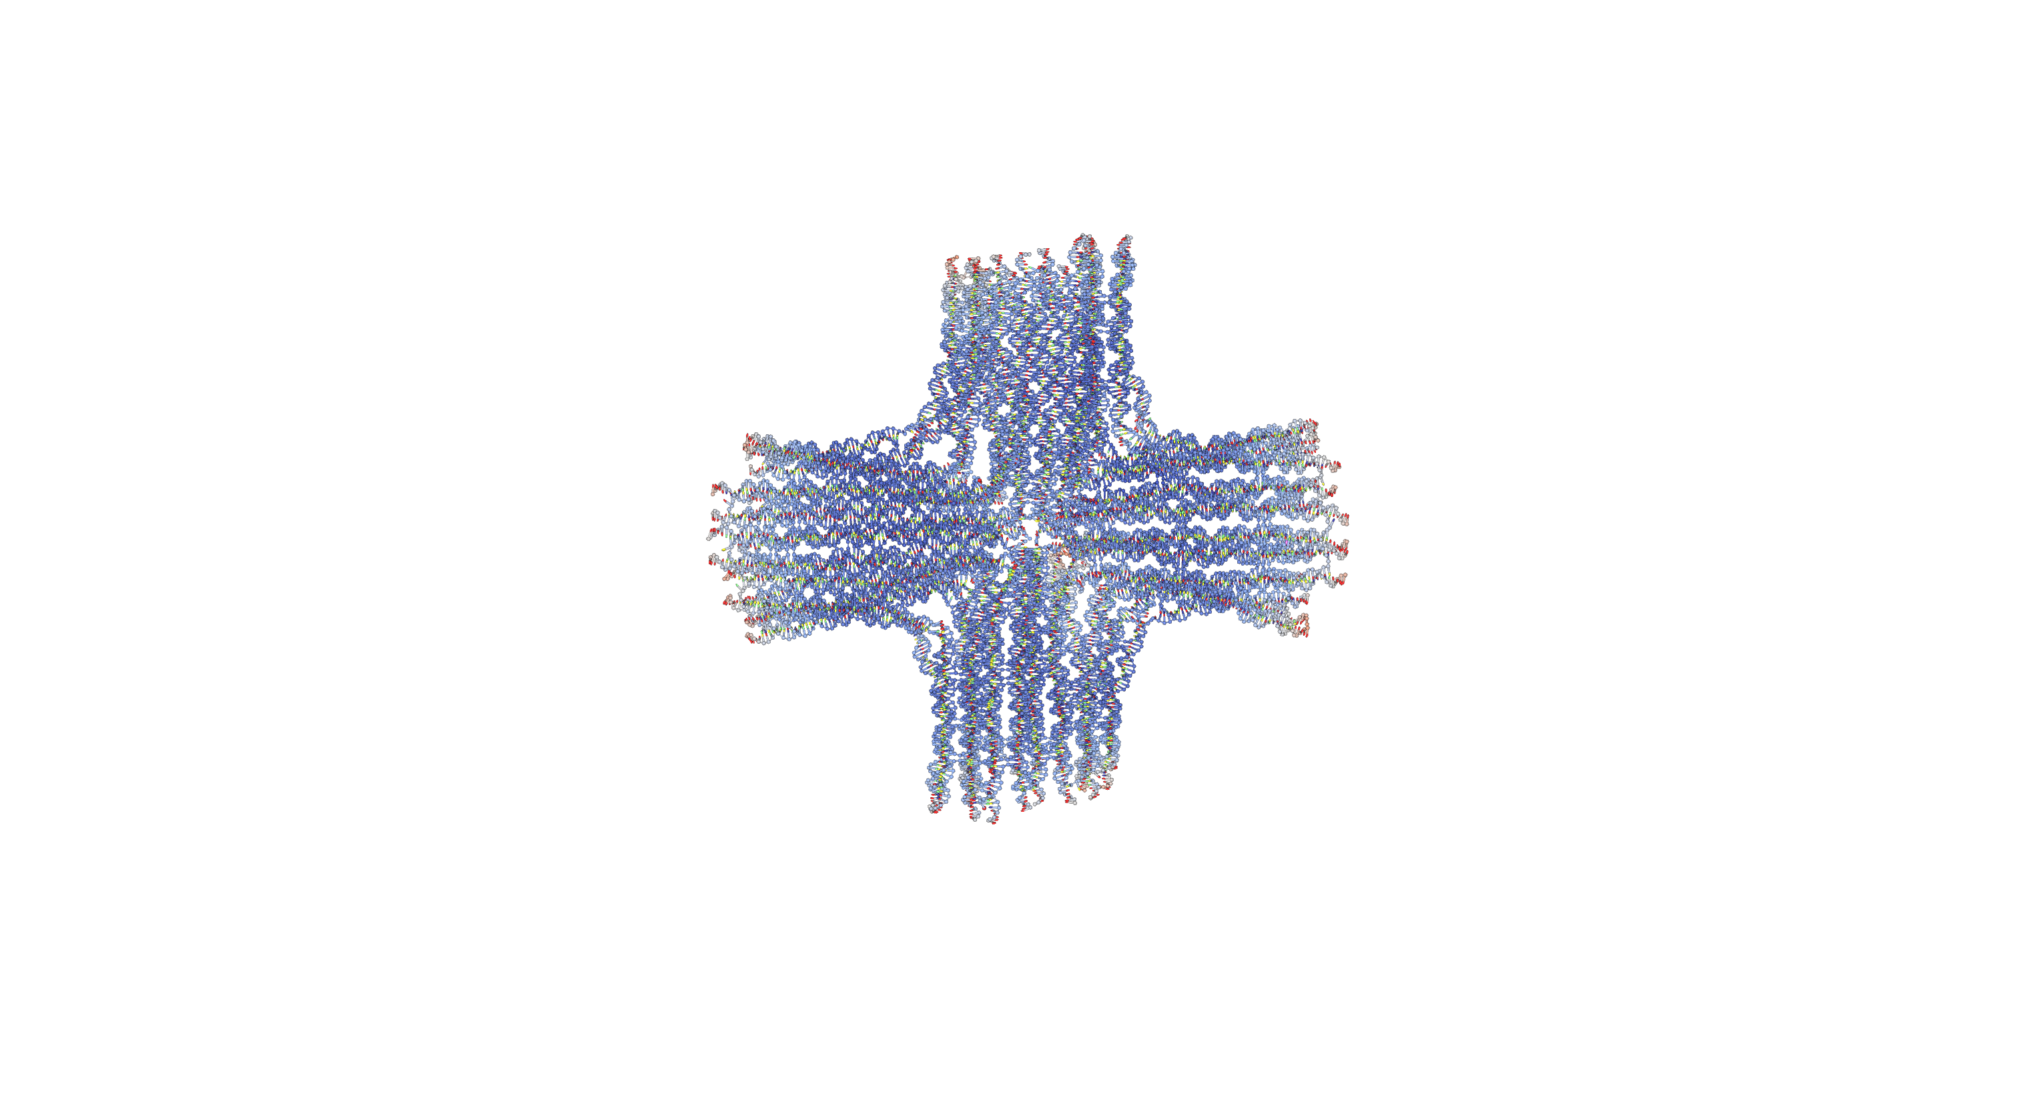
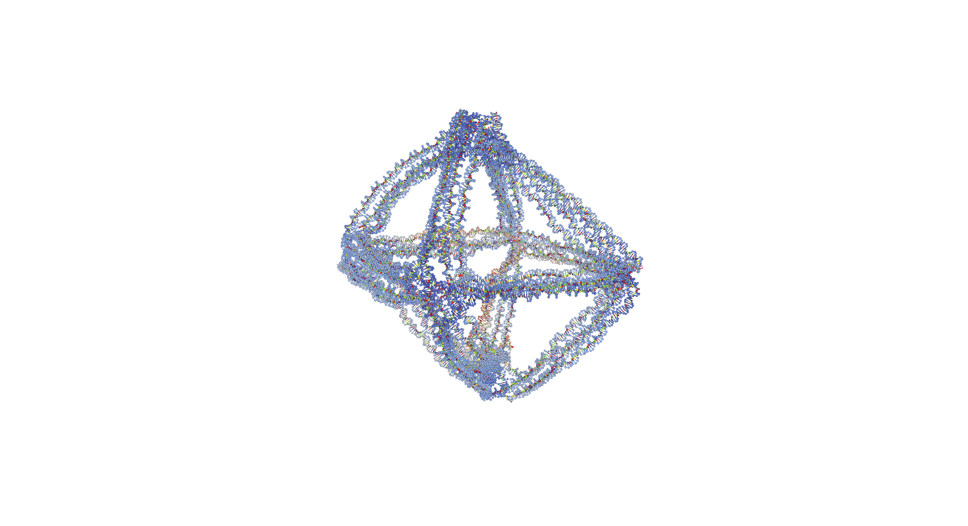

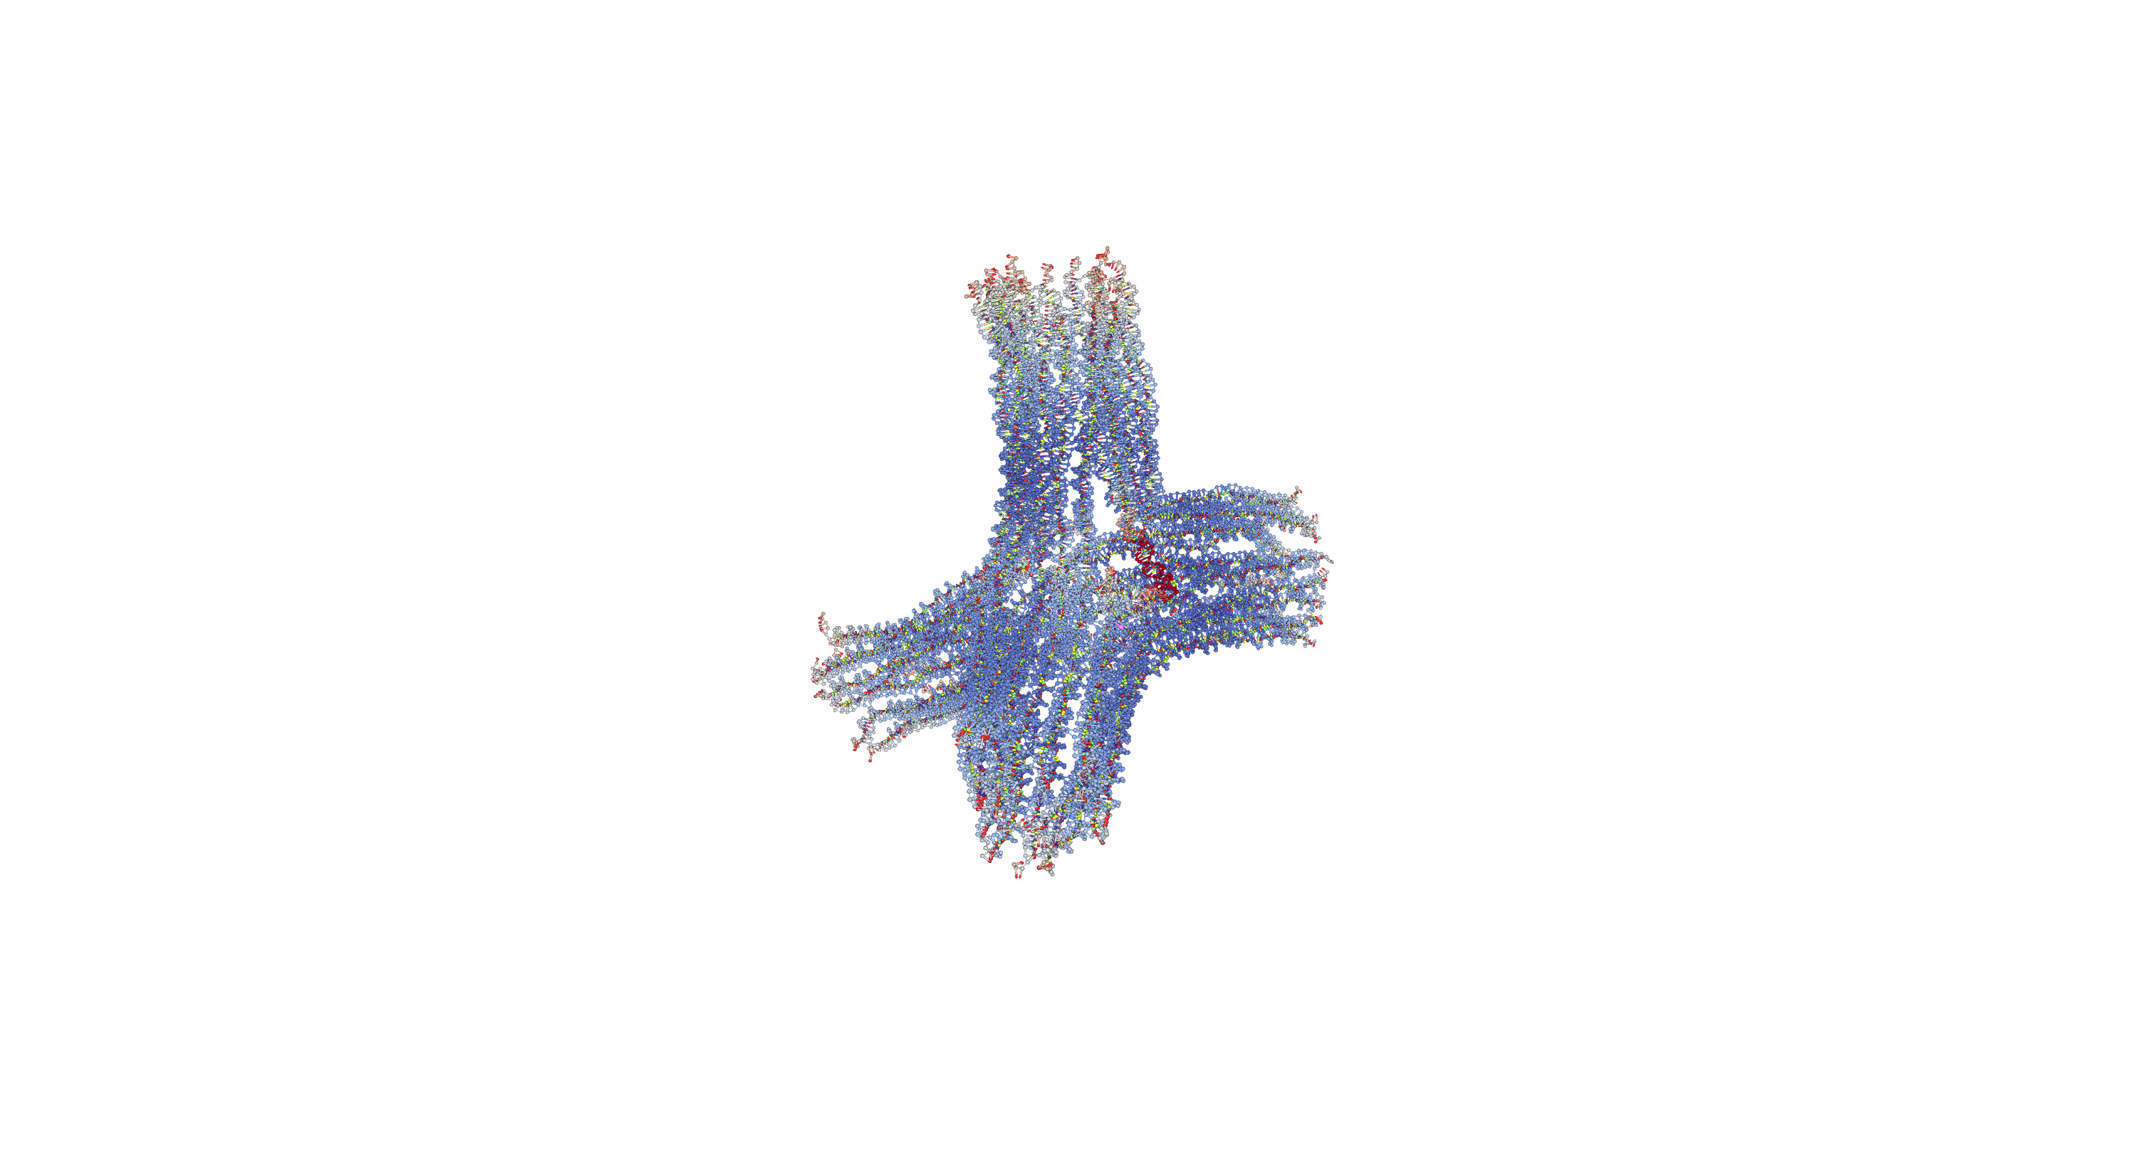
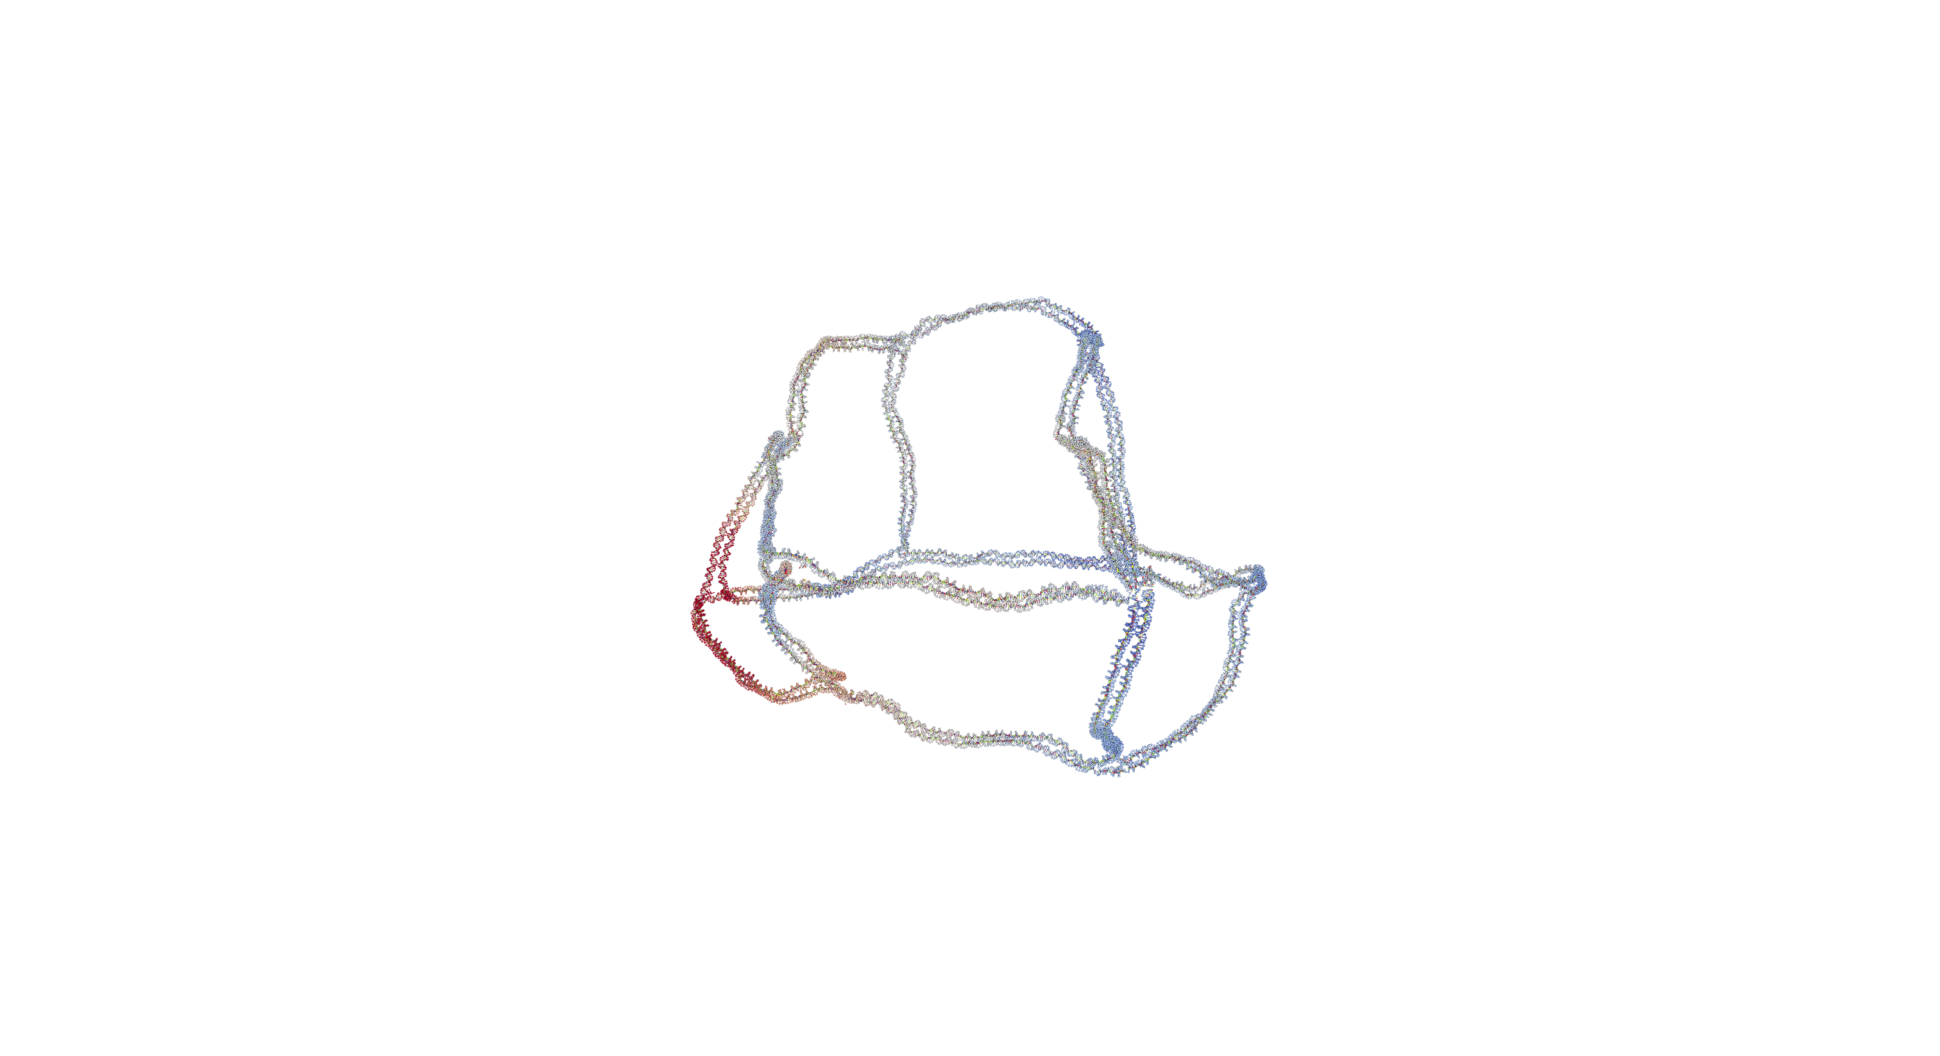
Coarse grain molecular dynamics verifies structural stability
Introduction
Methodology
Results
Conclusions
Q&A
Strut-based
Wireframe
Pre-simulation
Post-simulation
Pre-simulation
Post-simulation
Visualization from oxView: Poppleton, E. et al. Nucleic Acids Research 48, no. 12 (2020): e72.

Slide 16

A web-based UI is hosted through Streamlit Community Cloud for ease-of-access
Introduction
Methodology
Results
Conclusions
Q&A
Notes:
Describe how the nucleotide-level information is abstracted away during the design process and brought back at the design-export stage

Slide 17

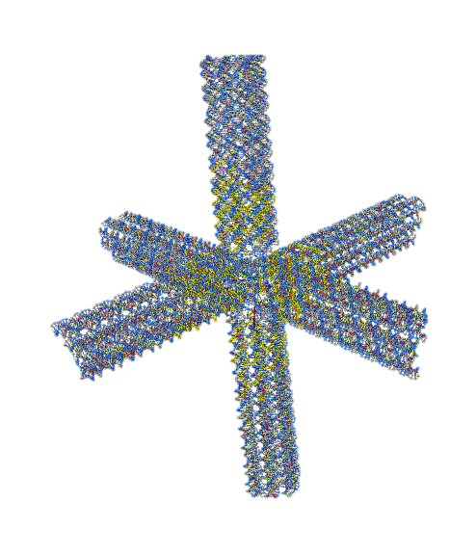
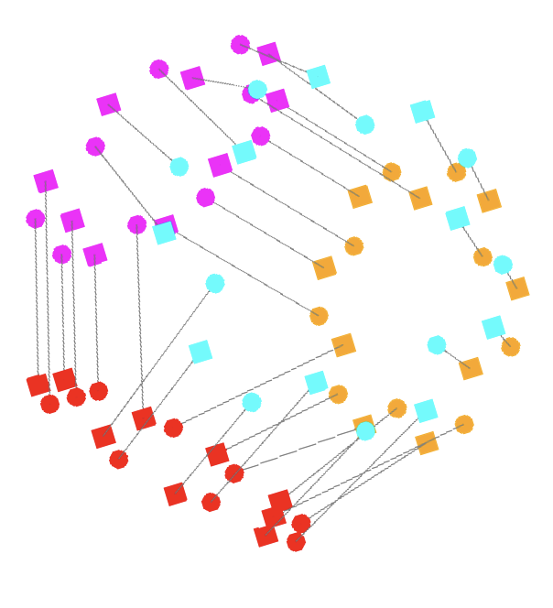
Introduction
Methodology
Results
Conclusions
Q&A
Conclusions
A sequential design automation protocol that can target a range of strut-based nanostructures
A web-based graphical user interface that abstracts away nucleotide-level design principles until final design export
Future work
In process of manufacturing a set of the shown nanostructures
Expanding a grammar¹ to enable design exploration of strut-based nanostructures
Support
NSF Grant Award CMMI-2113301
National Defense Science and Engineering Fellow
Input
Automation Algorithm
Output
Future work: Exploring colloidal metamaterials
+
+
+
35 nm
Specify N=18
Cycle
Cross section
Optimal Configuration
Mitering
1. Vetturini, A. J., Cagan, J., and Taylor, R. E., Nucleic Acids Research 53, no. 2 (2025): gkae1268.
Notes:
Sequetial meaning “Various steps of optimization”

Slide 18


Introduction
Methodology
Results
Conclusions
Q&A
Questions?
LinkedIn
Website

Slide 19
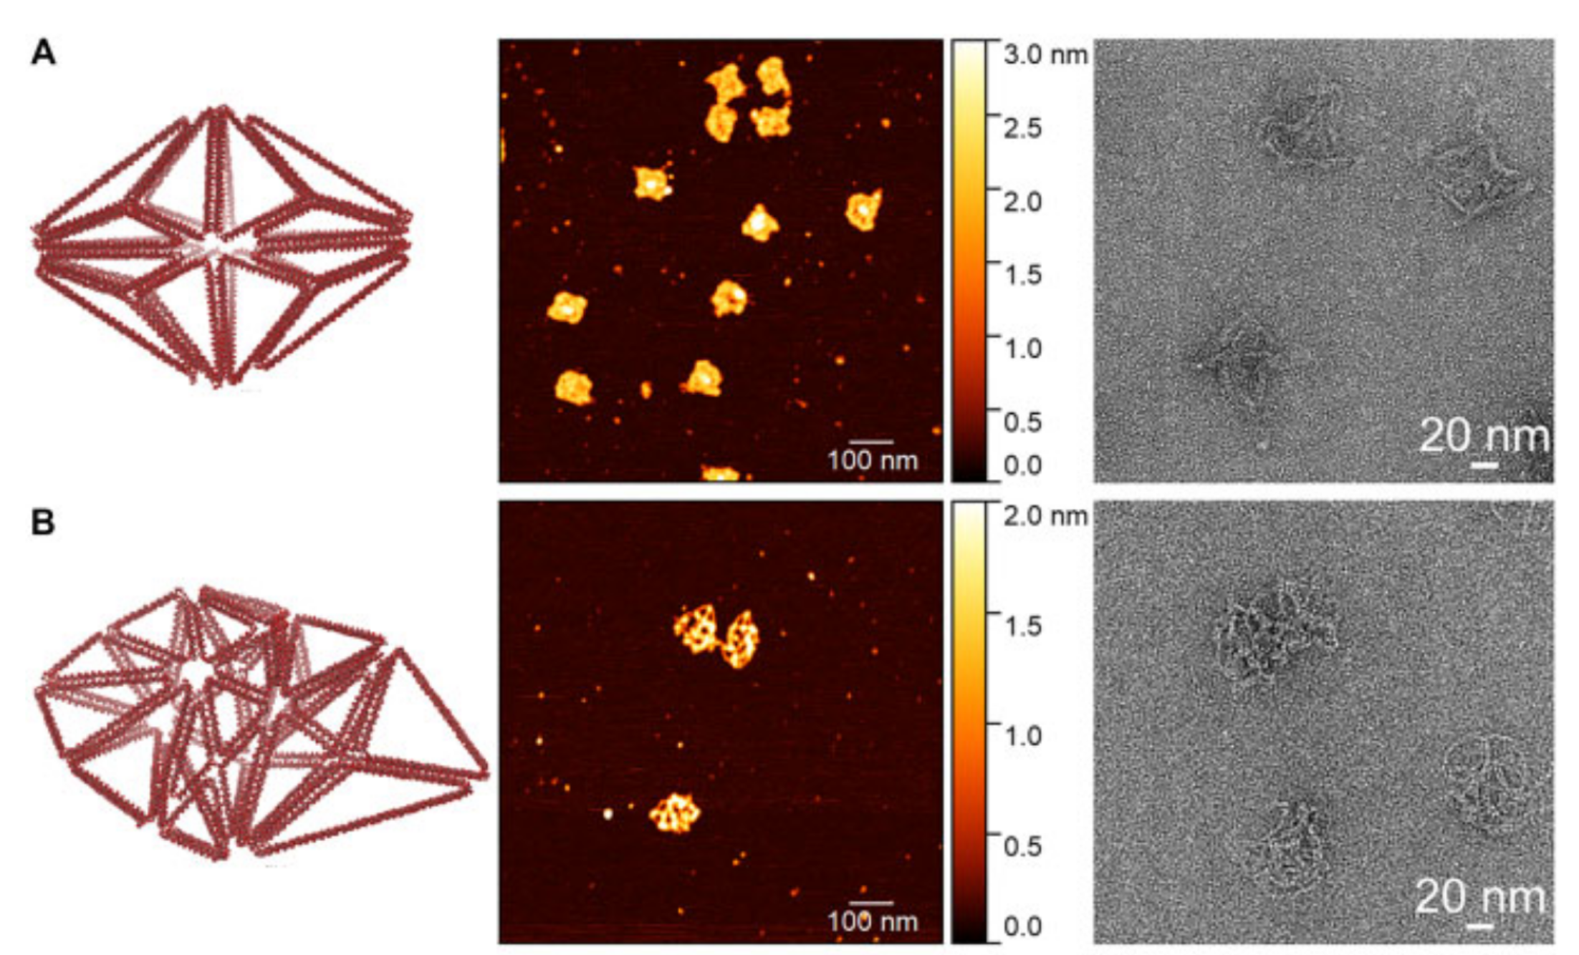
AFM
TEM
Image from Vetturini, A. J., Cagan, J., and Taylor, R. E., Nucleic Acids Research 53, no. 2 (2025): gkae1268.

Slide 20
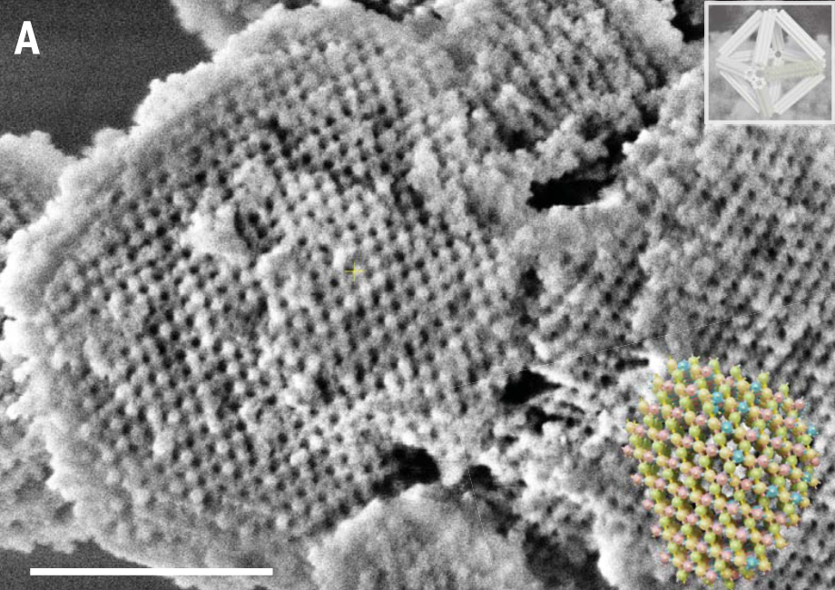



DNA origami also supports inorganic material design through colloidal assembly
Introduction
Methodology
Results
Conclusions
Q&A
Photonic Crystals
A
T
DNA serves as a template for silica
G
C
C
G
1 um
Pyrochlore crystal¹
Diamond cubic lattice²
Mechanical Metamaterials³
Sticky end sequences can be carefully designed to connect a superlattice¹ of DNA origami ”blocks”
1. Liu, H. et al. Science 384, no. 6697 (2024): 776–81.
2. Posnjak, G. et al. Science 384, no. 6697 (2024): 781–85.
3. Michelson, A. et al. Cell Reports Physical Science 4, no. 7 (2023).
Notes:
DNA origami serves as a template for another matierla (typically silica) through a modified Stober reaction consiiting of TMAP and TEOS (Tetraethyl orthosilicate)
Mechanical Metamaterial was a primitive cubic-like structure using a similar octahedron as shown in the slides from micro-mechanical testing systems using SEM for imaging and NanoFlip for testing with a 5 or 15 um diamond flat punch tip
,
DNA youngs modulus is around ~300-700 Mpa, but when you group it into helix bundles you can approach a plastic-like material
Photonics range from biosensing capabilities to optical computing / wave guides for quantum computing.

Slide 21
A design automation platform for strut-based nanostructures may enable analysis of mesoscale materials
Introduction
Methodology
Results
Conclusions
Q&A
Limitations of current automation tools
Routing relies on closed surface meshes that are non-trivial to create
Structures have limited mechanical tunability
Design tools require difficult installation procedures / add-ons to standard CAD tools
This works proposed solutions include
Edge-based routing for strut-based inputs
Automation that can target a variety of stiffness in the nanostructure cross-section
A web-based UI that abstracts away nucleotide-level design features
3D, strut-based nanostructures can not yet be automated and an automation platform for these types of structures may offer greater tunability for engineering colloidal metamaterials
Diamond cubic lattice¹
1. Posnjak, G. et al. Science 384, no. 6697 (2024): 781–85.
Notes:
The design automation limitation serves as the basis for the work shown today where …

Slide 22
From the optimal configuration, a continuous scaffold routing is found and a nucleotide-level design is exported
Introduction
Methodology
Results
Conclusions
Q&A
Scaffold routing is continuous and circular
To connect scaffold continuously
Start from a point that is a neighbor to the final connection
Add all possible optimal connections from E_{i} → E_{i+1}
Identify points not connected and add in through scaffold miniloops
+
Types of scaffold connections
Cycle
Optimal Configuration
…
E₁ → E₂ → E₃ → E₄ → E₁
Last Optimal Connection
…
Finally, autostaple¹ + use geometry of BDNA to export:
Unconnected
…
Unconnected
Standard connection
Inter-helix connection
Miniloop
1. Aksel, T., Navarro, E. J., Fong, N., and Douglas, S. M. Proceedings of the National Academy of Sciences 121, no. 48 (2024): e2406769121.
Notes:
Then just say “we do auto-stapling using a thermodynamics based model”

Slide 23




Strut-based structures form a contiguous outer ring to enable efficient usage of the limited scaffold
Introduction
Methodology
Results
Conclusions
Q&A
Select Examples
Compact helix arrangement:
Requires bending of DNA which requires a CAD-CAE workflow
Limits the unit cell size because scaffold is used to fill in the cross section
N<=6
Cross section
N=24
6<N<=8
A hollowframe enables more efficient use of the scaffold
max
s.t.
# neighbors > 1
N_{h,ring} = N_{max}
N=12
N=16
Helices are populated into discrete positions
Due to the scaffold length constraint, N is limited
Notes:
Describe how this is a discrete optimization (combinatiorial) problem that is typically “small enough” that DFS can be used to efficiently search the space. However, things like Simulated Annealing can also be used here.

Slide 24


Structural DNA nanotechnology leverages the properties of DNA to create nanostructures
Introduction
Methodology
Results
Conclusions
Q&A
DNA, the polymer
DNA, the structural material
DNA
Junction
Phosphate
backbone
Nucleotides
Nano
particle
https://www.britannica.com/science/DNA
Watson-Crick-Franklin base pairs
Nucleic acid junctions¹ allow for the design of nanometer-scale nanostructures
x
Cytosine
Adenine
Guanine
Thymine
1. Seeman, N. (1986). “Nucleic Acid Junctions and Lattices.” Journal of Theoretical Biology, 99 (2) 237-247.
Notes:
Before I can discuss design automation, I want to quickly discuss how DNA is used as a structural building material

